Slide 1
University of Diyala / College of Engineering Department of Chemical Engineering Windows 7
Preparing Lect. Omar A. Imran

Slide 2
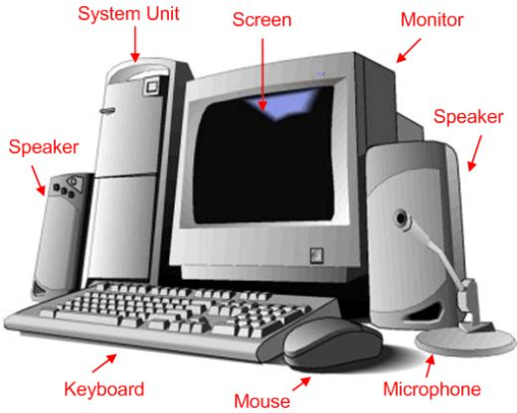
the first lecturer
To identify the structure of the computer

Slide 3
PC consists of two main sections:
First: - Entity steel Hardware
Input units (Input device)
units of output (Output device)
Central units

Slide 4
2. Second: - flexible entity (software) Software
Operating systems (OS)
Application programs

Slide 5
The units of measure computer
1 kilo bytes equal to 1024 bytes
1 megabyte equals 1024 kilobytes
1 Gigabyte is equal to 1024 megabytes
1 terabyte is equal to 1024 GB 1

Slide 6
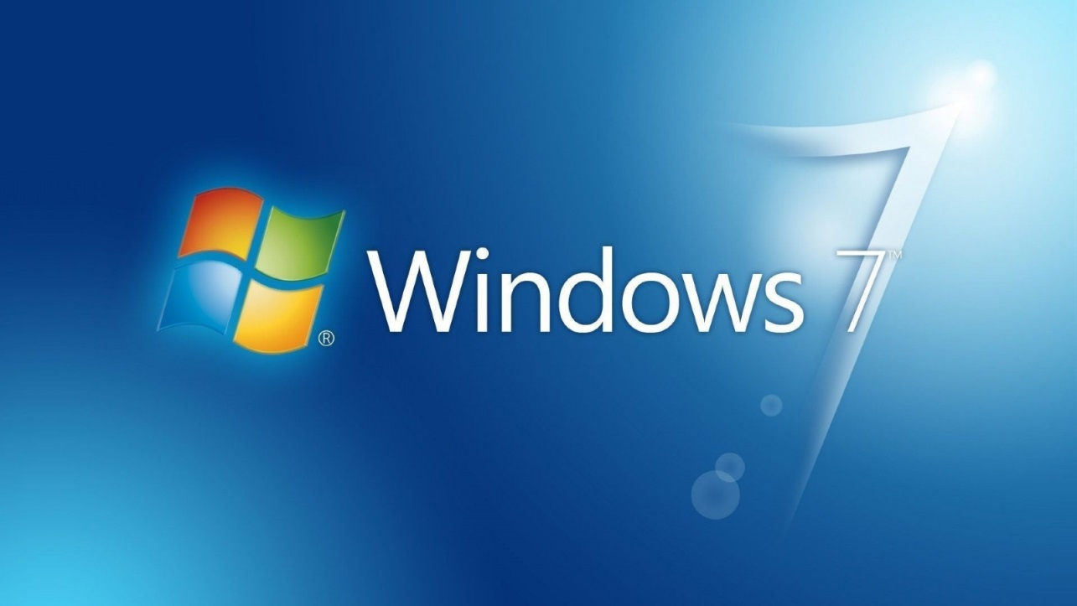
Getting started with Windows?
When you start the computer, we must wait for the operating system until the sequel to quit and make sure to quit the full emergence of the surface is called the desktop by special codes work we of which deal with the computer and computer software on the desktop note the existence of shares we control its mouse device according to the movement of the user's mouse moves the cursor on the desktop vertically and horizontally on each desktop.

Slide 7
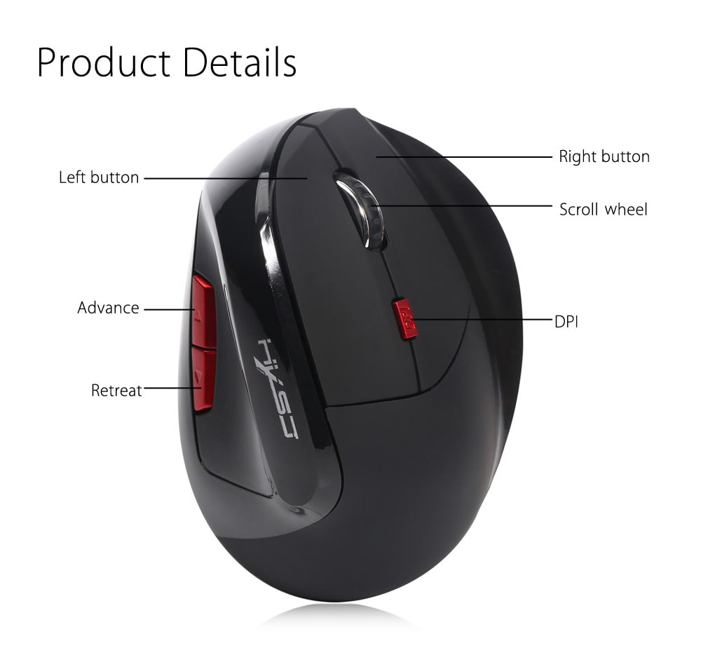
MOUSE
Mouse is used to interact with the elements on the screen, such as using hands to deal with objects in reality. You can move objects, open, or changed or dropped, and other things you can accomplish.
And contains two buttons on the main two:
secondary mouse button: it is the right button on the mouse button, which we use to display the shortcut menus or other features for the programs.
primary mouse button: left button is in most of the devices we use the mouse button to click or double click. And its many functions, namely:

